Slide 1



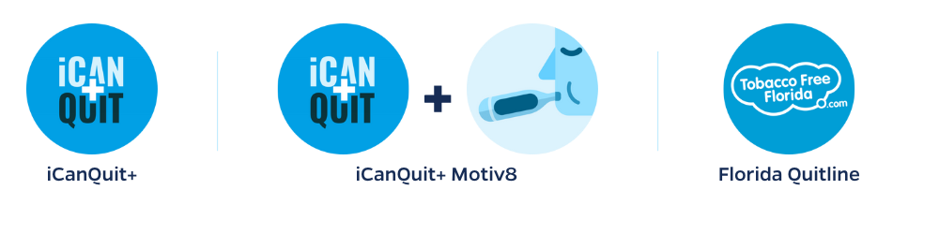


Stakeholder Engagement for a Comparative Effectiveness Trial of Mobile Health Smoking Cessation Approaches Among Underserved Patients
            Melissa Bou Malham, MD¹, Alexandra Fahnlander¹, Ryan Theis, PhD¹ , Mario El Hayek, MD¹, Shirley Bloodworth², Jonathan Bricker PhD³, Ji-Hyun Lee, DrPH⁴, Christopher Cogle, MD⁵, Maribeth Williams, MD⁵, Jihane Naous, MD⁵ , Shaunak Mulani, MD⁵, Jesse Dallery, PhD⁶ & Ramzi G. Salloum, PhD^{1,7}
Department of Health Outcomes and Biomedical Informatics, University of Florida College of Medicine¹, Health Outcomes and Policy, University of Florida², Department of Psychology, University of Washington³, Department of Biostatistics, University of Florida⁵ Department of Medicine, University of Florida⁵, Department of Psychology, University of Florida⁶, Health Cancer Center, University of Florida⁷
Background
iCanQuit+
Motiv8
Results
A smartphone-based acceptance and commitment and therapy (ACT) application
UF developed incentive-based contingency management (CM) therapy based on participant CO output
Tobacco smoking remains the leading cause of preventable disease, disability, and death
Mobile health (mHealth) treatments for smoking cessation have been shown to increase access to smoking cessation treatment
Stakeholders have been engaged in preparing a comparative effectiveness trial that compares two mHealth smoking treatments against each other and referral to the Tobacco Free Florida Phone Quit program
Stakeholders involved include patients, community-based organizations, clinicians, health systems representatives, policy makers, payers, and subject area experts
Pre-Trial SAC Meetings:
Health system, clinician, and payer group panel:
  Recommended engaging clinical champions at each clinic
  Informed best methods for research assistants (RAs) engagement with care team staff
    RA flagging potential participants based on visit schedules
    Encouraged competition among providers to increase referral rates
Patient and community:
  Recognized the importance of having different ways to follow-up with patients
Tobacco Cessation Referral Training:
Provided an opportunity to build relationships with care team members
Reviewed methods for connecting patients via study staff
Care Team Interviews:
Provided insight on care team knowledge and beliefs about referral methods and interventions
Consensus that there is a strong need for referrals to evidence-based interventions
Suggested that nursing staff are key players in the completion of screening
Figure 1. mHeath Applications Description
Planning the Study | Conducting the Study | Disseminating Study Results
Integrated feedback from stakeholders in developing research questions, outcomes, and study design | Described how partners will participate in the study conduct | Described how stakeholders will be involved in disseminating study results clearly
Partners reviewed the research plan and abstract and ensured interventions benefit the populations each stakeholder represents | Stakeholders advised on the cultural tailoring of interventions and recruitment of diverse patient populations with a special focus on the Florida Latino population | OneFlorida+ will be used to disseminate study findings to medical institutions, community payers, health clinics, providers, and patients.
Figure 2. PCORI’s Engagement Rubric
Methods
PCORI’s Engagement Rubric provided guidance on methods for engaging stakeholder partners throughout each phase of a research study.
Biannual SAC panels
Quarterly study newsletters
Targeted engagement activities
Tobacco cessation referral training
Workflow Observation
Pre-trial qualitative interviews
Patients will be randomized into one of three arms offered in both English and Spanish
All treatment arms are evidence-based and can improve smoking cessation among patients
Pre-Award
Pre-Trial
Trial Recruitment (33-month period)
Analysis
Conclusion
Identified members of the Stakeholder Advisory Committee (SAC) and their roles
Dissemination of ongoing retention and recruitment rates online via R shiny app
Targeted engagement activities with SAC partners and care teams
Feedback from stakeholder engagement activities provided meaningful direction for increasing and maintaining clinic engagement during recruitment.

