Slide 1

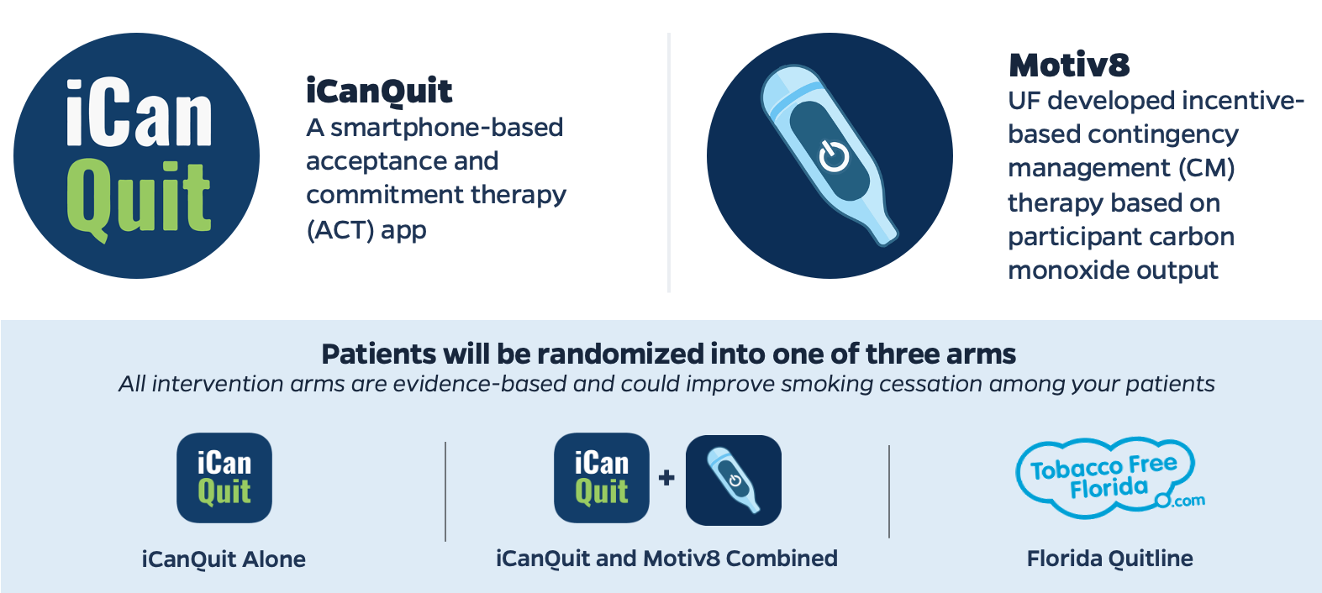



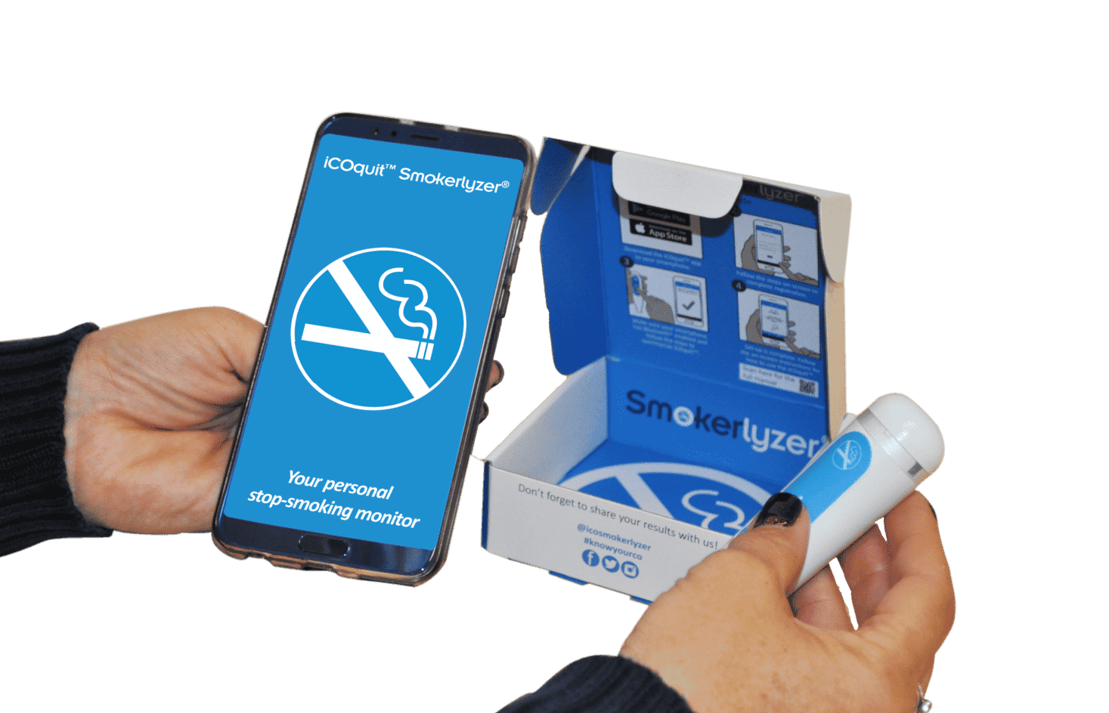


Stakeholder Engagement Plan for Comparative Effectiveness of Mobile Health Smoking Cessation Approaches among Underserved Patients in Primary Care
Melissa Bou Malham, M.D.¹, Kathryn Pluta, Ph.D.^{1,2}, Alexandra Fahnlander¹, Brianna Nordelo¹, Jesse Dallery, Ph.D.³ & Ramzi G. Salloum, Ph.D.^{1,2}
Department of Health Outcomes and Biomedical Informatics, University of Florida College of Medicine¹, University of Florida Health Cancer Center², Department of Psychology, University of Florida³
Background
Results
Tobacco use remains a global public health issue killing over 8 million people yearly
Referral to smoking cessation interventions, of any kind, does not occur routinely in health care settings
Mobile health (mHealth) interventions can dramatically increase access to smoking cessation treatment
iCanQuit and Motiv8 are efficacious in diverse populations, including people with low literacy (high school or less), racial and ethnic minorities, and those living in rural areas
The effects of these treatments will be measured in vulnerable subgroups based on gender, race, ethnicity, rurality, and social vulnerability
The team of stakeholders is currently providing us with the best approach to our target population
SAC Meetings:
Patient and community user group: addressed potential barriers to participant enrollment such as rural access to Wi-Fi and explained their concerns and suggestions such as using simpler language
Health system, clinician, and payer group: addressed aiding patients without a phone and maintaining clinic engagement over a 33-month period
Provider Training Interviews:
All members provided positive feedback about the AAC method
Workflow Evaluation:
Will commence soon and findings will be shared with clinic partners
Enrollment kickoff will occur at the UF Health Family Medicine - Main clinic
ASK
patients about smoking status
ADVISE
patients to quit smoking
CONNECT
patients with a smoking cessation intervention
Figure 1: Promote UP Study Arms
Figure 2: Tobacco Cessation Referral Method
Methods
Conclusion
Engaging stakeholders: patients, researchers, community-based organizations, providers, Citizen Scientists, policy makers, payers
Clarify roles of each member
Sharing recruitment and retention rates
Discussing barriers and facilitators
Confirm that low socioeconomic status is not a barrier for enrollment
Aid patients without a phone
Maintain recruitment over the 33-month period
Potential adaptations should be considered including improvements related to:
  Smartphone access
  Wi-Fi availability
  Patient retention
Partners highlighted the importance of providing more support to patients who smoke, increasing access to treatment, and working together to identify and overcome barriers to treatment
The SAC will continue to be engaged throughout the enrollment process
Pre-Award
Pre-Trial
Trial Recruitment
Analysis & Dissemination
Biannual Stakeholder Advisory Committee & User Group Panels
Targeted stakeholder engagement activities
Tobacco Cessation Referral training
Workflow observation
Pre-trial provider qualitative interviews
User group panel meetings
Engaging the OneFlorida Citizen Scientist Program
Collaborating with UF County Extension and its Associate Dean and the UF Cancer Center’s Community Outreach and Engagement office and its Associate Director
Figure 3: The Stakeholder Engagement Plan
Research is funded by a Patient-Centered Outcomes Research Institute (PCORI) award (PCS-2021C1-22,391).

