Slide 1


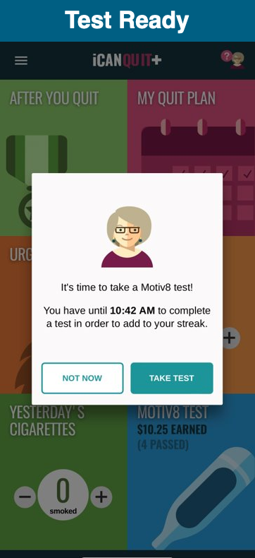
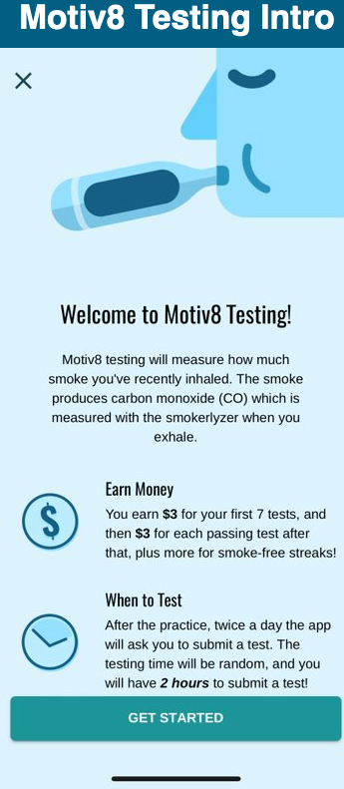
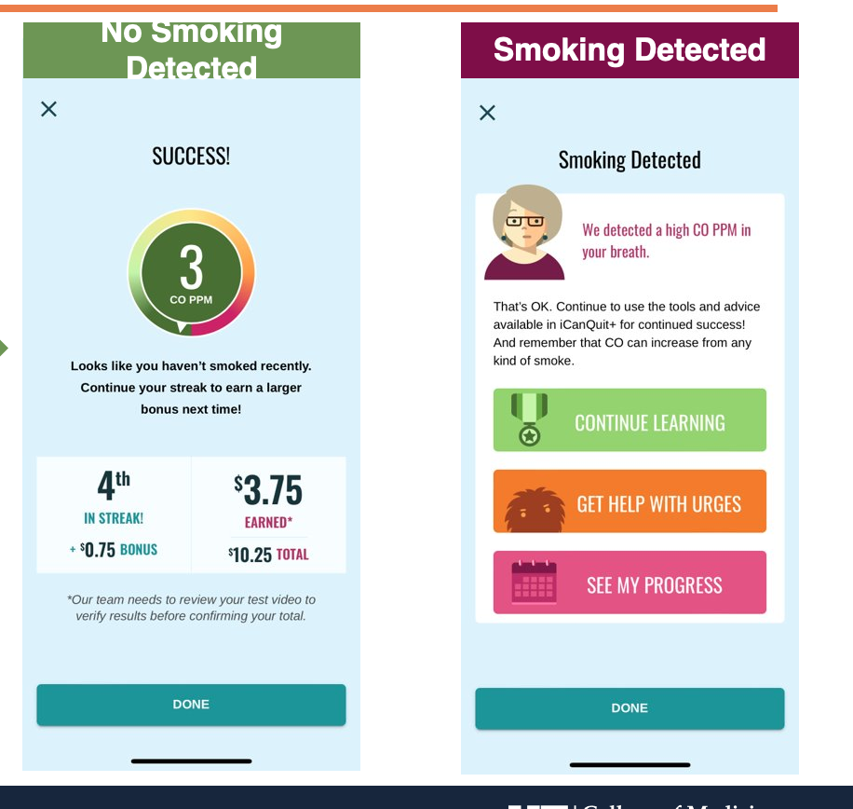
Adult primary care patients who smoke
(n=1,332)
ASK
ADVISE
CONNECT
Comparative Effectiveness of Mobile Health Smoking Cessation Approaches Among Underserved Patients in Primary Care
TOBACCO SMOKING IS THE LEADING CAUSE OF PREVENTABLE DISEASE, DISABILITY, & DEATH
ACT-Based
ACT + CM
Usual Care
Cassandra O’Hara, M.S., Melissa Bou Malham, M.D., Ryan Theis, Ph.D., Mario El Hayek, M.D., Jonathan Bricker PhD, Ji-Hyun Lee, DrPH, Christopher Cogle, M.D., Maribeth Williams, M.D., Jihane Naous, M.D., Shaunak Mulani, M.D., Hailey Donohue, M.A., Kiah Kramer, B.A., B.S., Ramzi G. Salloum, Ph.D., & Jesse Dallery, Ph.D.
University of Florida
Referred to study
(158)
Pending (10)
Excluded (76)
-Didn’t meet inclusion criteria (33)
-Declined (36)
-Other (7)
iCanQuit
(24)
iCanQuit+Motiv8
(24)
Florida Quitline
(24)
Referred to study
(72)
AIMS
Compare effectiveness of two evidence-based mobile health aids and the Florida Quitline
Assess how and for whom the interventions help patients in achieving smoking abstinence
Identify barriers and facilitators to implementing the intervention in clinical practice
OUTCOME MEASURES
BASELINE
2-MONTHS
1-YEAR
*6-MONTHS
*primary outcome
Notes:
Notes:
In Powerpoint, click View > Guides
Keep text within gutter guides.
Author list: Don’t split names onto two lines (e.g., “Jimmy [break] Smith”). If that happens, use a new line, unless you need the space. Bold the first names of anybody who’s presenting in person.
Intro/methods/result: Do not drop below font size 28, but if you have extra space, jack up the font size until the space is full.
Do not use color in the sidebars except in graphs/figures. It’ll pull attention from the center and slow interpretation for passersby.

